Slide 1
Introduction to Machine Learning
Image Descriptor
Classification
ML Classifier

Slide 2
Feature Descriptor
For an image?

Slide 3
What is learning?
"The activity or process of gaining knowledge or skill by studying, practicing, being taught, or experiencing something."
Merriam Webster dictionary

Slide 4
What is Machine Learning (ML)?
“Learning is any process by which a system improves performance from experience.”
- Herbert Simon
Definition by Tom Mitchell (1998):
Machine Learning is the study of algorithms that
improve their performance P
at some task T
with experience E.
A well-defined learning task is given by <P, T, E>.
3

Slide 5
Why Machine Learning?
For many problems, it’s difficult to program the correct behavior by hand
recognizing people and objects
understanding human speech
Machine learning approach: program an algorithm to automatically learn from data, or experience

Slide 6
Why ML?
Why might you want to use a learning algorithm?
hard to code up a solution by hand (e.g. vision, speech)
system needs to adapt to a changing environment (e.g. spam
detection)
want the system to perform better than the human programmers
privacy/fairness (e.g. ranking search results)

Slide 7
AI
Nowadays, machine learning" is often brought up with artificial intelligence" (AI)
AI does not always imply a learning-based system
Symbolic reasoning
Rule-based system
Tree search
Learning-based system -> learned based on the data -> more flexibility, good at solving pattern recognition problems.

Slide 8
Relations to Human Learning
Human learning is:
Very data efficient
An entire multitasking system (vision, language, motor control, etc.)
Takes at least a few years :)
For serving specific purposes, machine learning doesn't have to look like human learning in the end.
It may borrow ideas from biological systems, e.g., neural networks.
It may perform better or worse than humans.

Slide 9
Traditional Programming
Data Program
Computer
Output
Machine Learning
Data Output
Computer
Program
4
Slide credit: Pedro Domingos

Slide 10
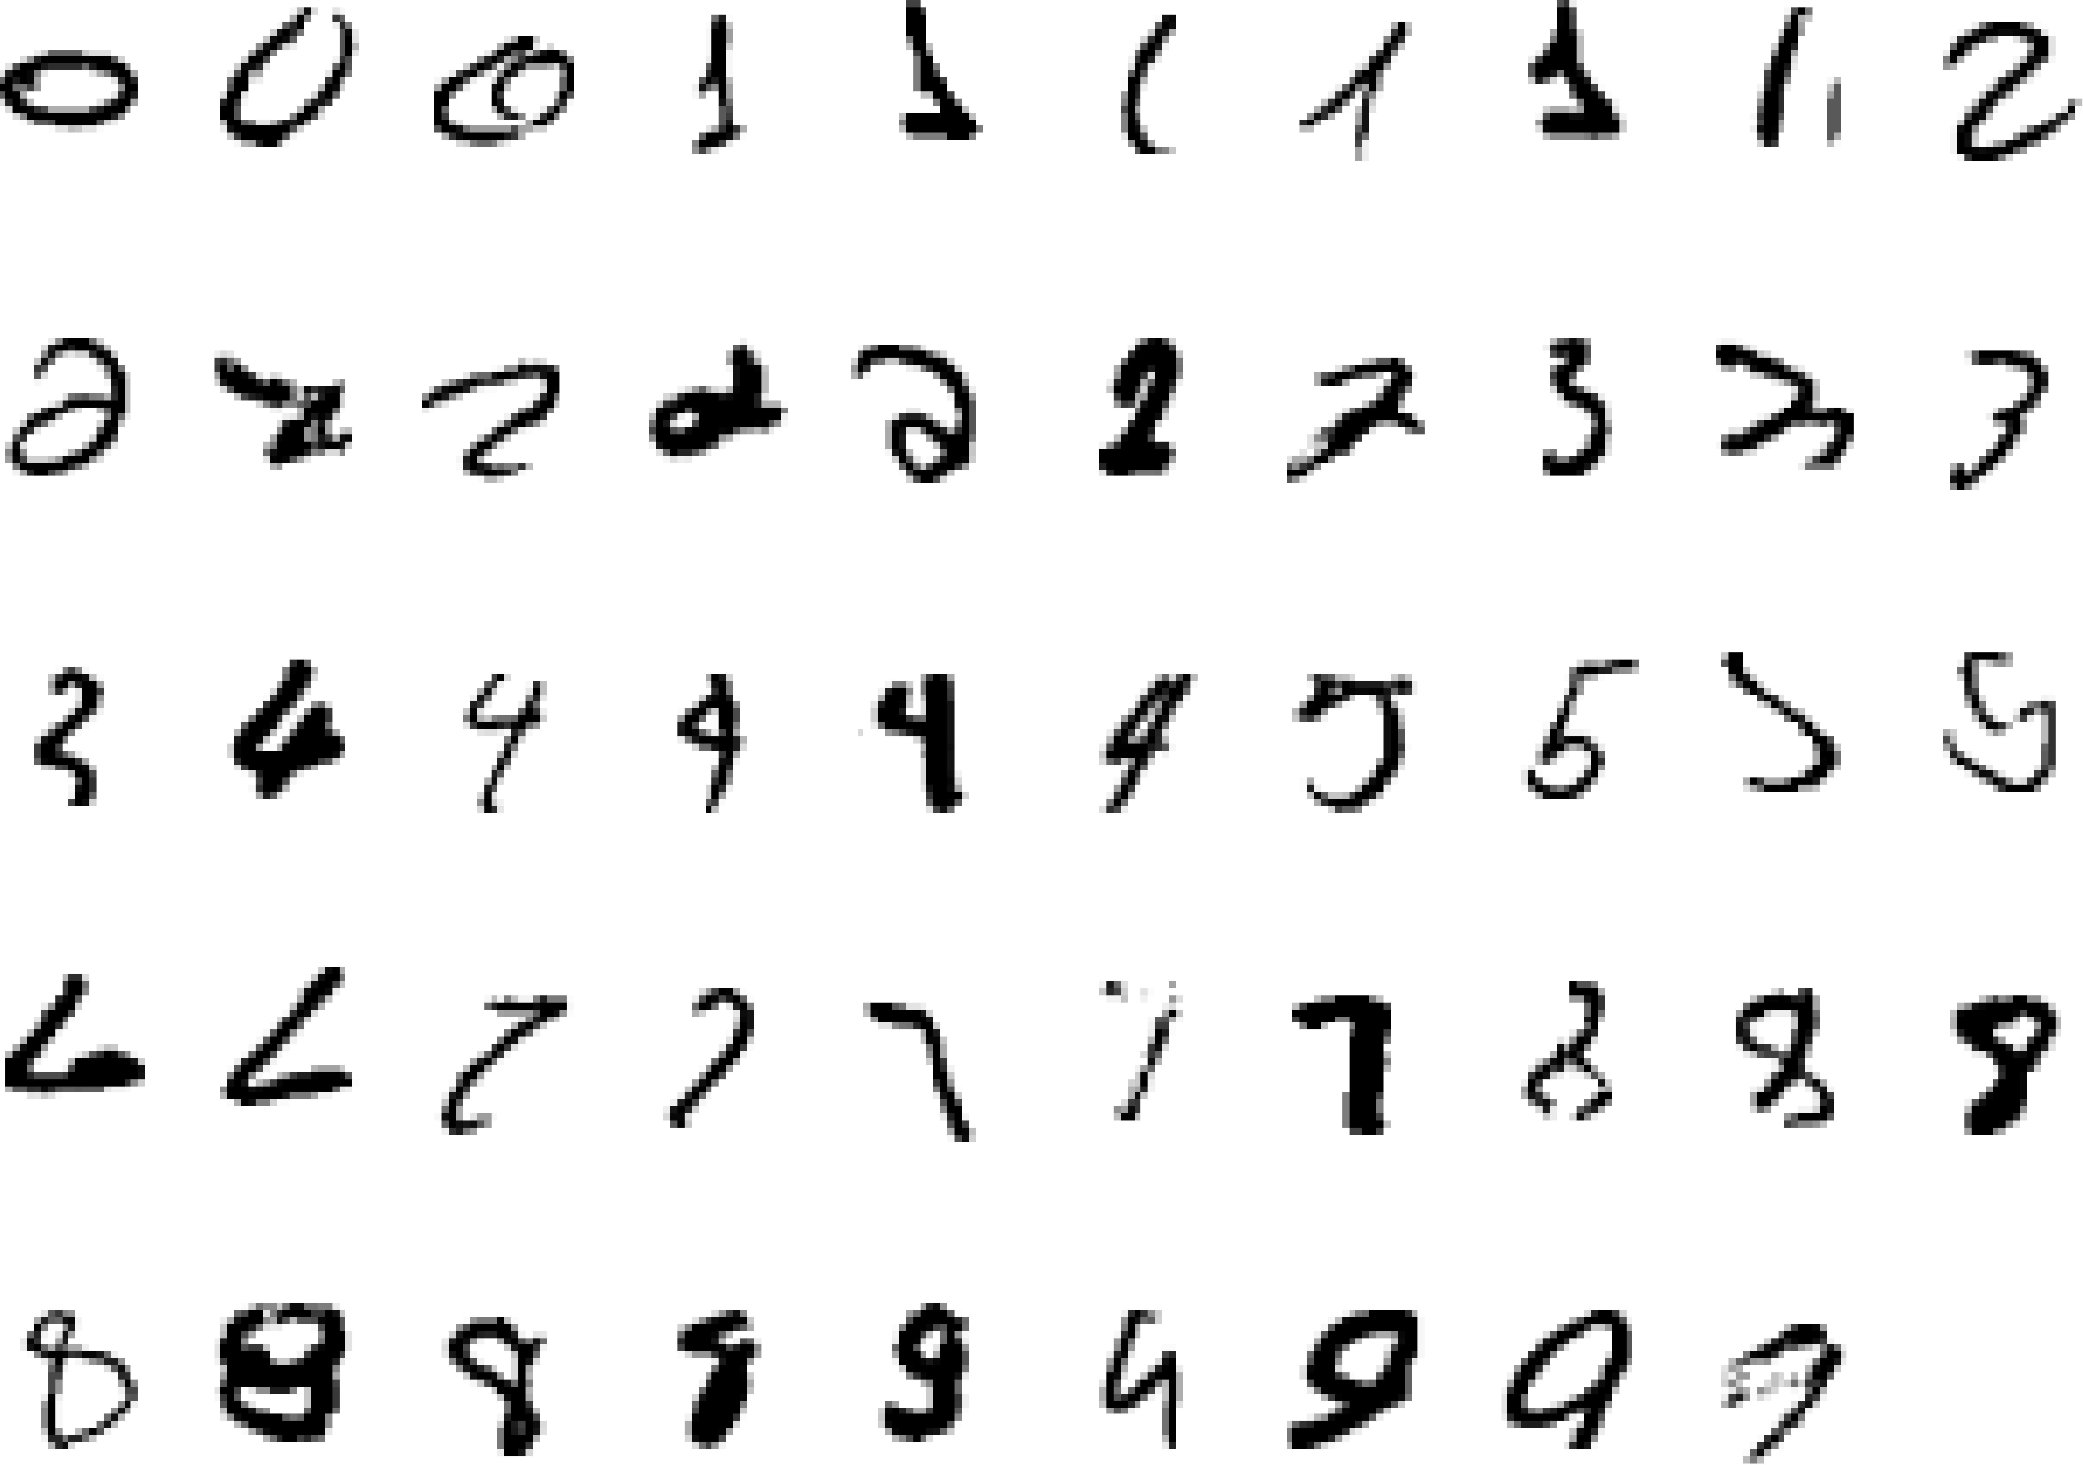
A classic example of a task that requires machine learning: It is very hard to say what makes a 2
6
Slide credit: Geoffrey Hinton

Slide 11
Some more examples of tasks that are best solved by using a learning algorithm
Recognizing patterns:
Facial identities or facial expressions
Handwritten or spoken words
Medical images
Generating patterns:
Generating images or motion sequences
Recognizing anomalies:
Unusual credit card transactions
Unusual patterns of sensor readings in a nuclear power plant
Prediction:
Future stock prices or currency exchange rates
7
Slide credit: Geoffrey Hinton

Slide 12
Sample Applications
Web search
Computational biology
Finance
E-commerce
Space exploration
Robotics
Information extraction
Social networks
Debugging software
[Your favorite area]
8
Slide credit: Pedro Domingos

Slide 13
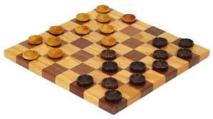
Samuel’s Checkers-Player
“Machine Learning: Field of study that gives computers the ability to learn without being explicitly programmed.” -Arthur Samuel (1959)
9

Slide 14
Defining the Learning Task
Improve on task T, with respect to performance metric P, based on experience E
T: Playing checkers
P: Percentage of games won against an arbitrary opponent E: Playing practice games against itself
T: Recognizing hand-written words
P: Percentage of words correctly classified
E: Database of human-labeled images of handwritten words
T: Driving on four-lane highways using vision sensors
P: Average distance traveled before a human-judged error
E: A sequence of images and steering commands recorded while observing a human driver.
T: Categorize email messages as spam or legitimate. P: Percentage of email messages correctly classified. E: Database of emails, some with human-given labels
10
Slide credit: Ray Mooney

Slide 16
Types of Learning
Supervised (inductive) learning
Given: training data + desired outputs (labels)
Unsupervised learning
Given: training data (without desired outputs)
Semi-supervised learning
Given: training data + a few desired outputs
Reinforcement learning
Rewards from sequence of actions
24
Based on slide by Pedro Domingos

Slide 17
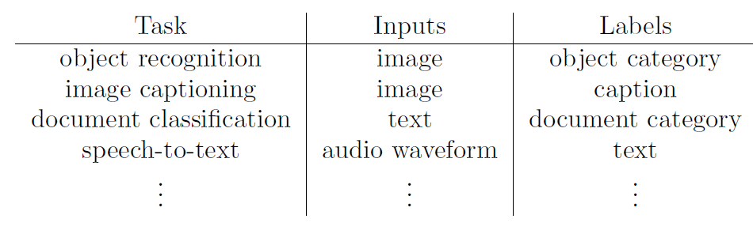
Supervised Learning
This means we are given a training set consisting of inputs and corresponding labels, e.g.

Slide 18
Input Vector
Machine learning algorithms need to handle lots of types of data: images, text, audio waveforms, credit card transactions, etc.
Common strategy: represent the input as an input vector in R^{d}
Representation = mapping to another space that's easy to manipulate
Vectors are a great representation since we can do linear algebra!

Slide 19
Input Vector
Use raw pixels
Or meaningful feature descriptor/vector

Slide 20
Mathematically, our training set consists of a collection of pairs of an input vector x ∈ R^{d} and its corresponding target, or label, t
Regression: t is a real number (e.g. stock price)
Classification: t is an element of a discrete set {1,…., C}
These days, t is often a highly structured object (e.g. image)
Denote the training set {(x⁽¹⁾, t⁽¹⁾)…. (x^{(N)}, t^{(N)})}
Note: these superscripts have nothing to do with exponentiation!

Slide 21



Supervised Learning: Regression
Given (x₁, y₁), (x₂, y₂), ..., (x_{n}, y_{n})
Learn a function f(x) to predict y given x
– y is real-valued == regression
9
8
7
6
5
4
3
2
1
0
1970 1980
September Arctic Sea Ice Extent (1,000,000 sq km)
1990 2000
2010
2020
Year
Data from G. Witt. Journal of Statistics Education, Volume 21, Number 1 (2013)
26

Slide 22










Supervised Learning: Classification
Given (x₁, y₁), (x₂, y₂), ..., (x_{n}, y_{n})
Learn a function f(x) to predict y given x
– y is categorical == classification
Cancer (Malignant / Benign)
1(Malignant)
0(Benign)
Tumor Size
27
Based on example by Andrew Ng

Slide 23







Supervised Learning: Classification
Given (x₁, y₁), (x₂, y₂), ..., (x_{n}, y_{n})
Learn a function f(x) to predict y given x
– y is categorical == classification
Cancer (Malignant / Benign)
1(Malignant)
0(Benign)
Tumor Size
Tumor Size
Based on example by Andrew Ng

Slide 24






Supervised Learning: Classification
Given (x₁, y₁), (x₂, y₂), ..., (x_{n}, y_{n})
Learn a function f(x) to predict y given x
– y is categorical == classification
Cancer (Malignant / Benign)
1(Malignant)
0(Benign)
Tumor Size
Predict Benign Predict Malignant
Tumor Size
Based on example by Andrew Ng

Slide 25










Supervised Learning
x can be multi-dimensional
– Each dimension corresponds to an attribute
Clump Thickness
Uniformity of Cell Size
Uniformity of Cell Shape
…
Age
Tumor Size
30
Based on example by Andrew Ng

Slide 26
















Unsupervised Learning
Given x₁, x₂, ..., x_{n} (without labels)
Output hidden structure behind the x’s
– E.g., clustering
31

Slide 27
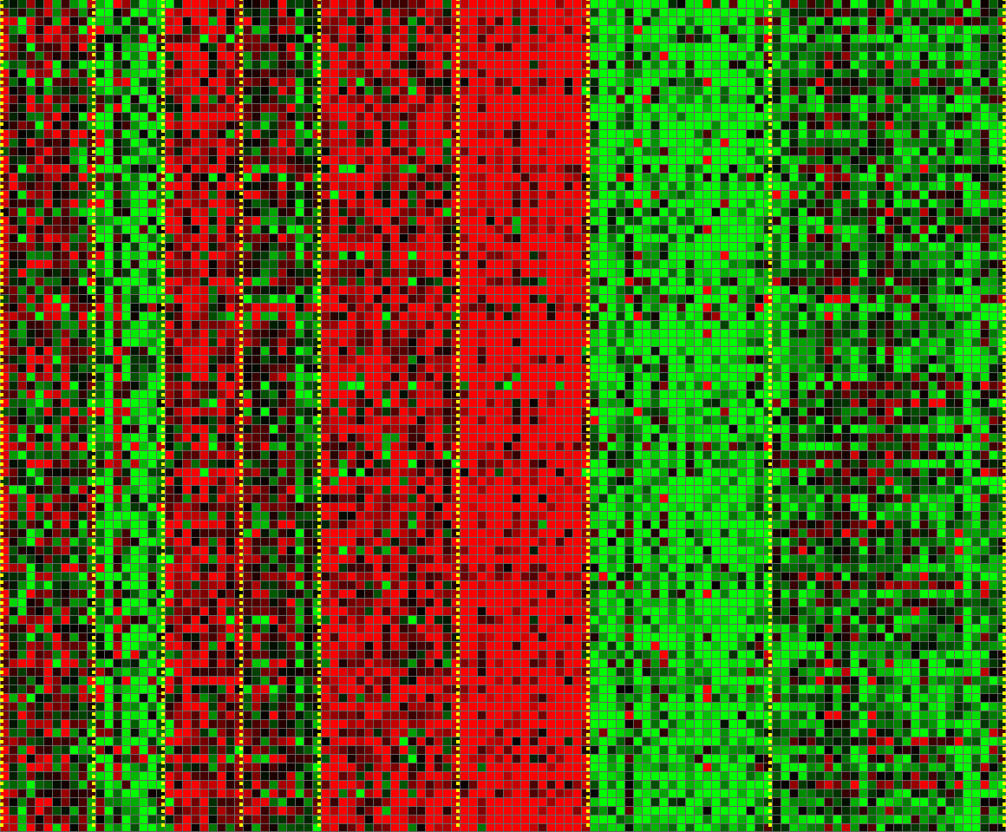
Unsupervised Learning
Genomics application: group individuals by genetic similarity
Genes
Individuals
32
[Source: Daphne Koller]

Slide 28
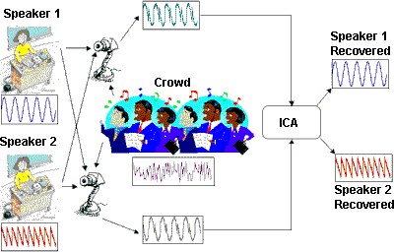


Unsupervised Learning
Independent component analysis – separate a combined signal into its original sources
Image credit: statsoft.com Audio from http://www.ism.ac.jp/~shiro/research/blindsep.html

Slide 29
Unsupervised Learning
Independent component analysis – separate a combined signal into its original sources
Image credit: statsoft.com Audio from http://www.ism.ac.jp/~shiro/research/blindsep.html

Slide 30
Reinforcement Learning
Given a sequence of states and actions with (delayed) rewards, output a policy
Policy is a mapping from states → actions that tells you what to do in a given state
Examples:
Credit assignment problem
Game playing
Robot in a maze
Balance a pole on your hand
36

Slide 31
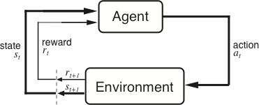
The Agent-Environment Interface
Agent and environment interact at discrete time steps Agent observes state at step t : s_{t} ∈S
: t = 0, 1, 2, K
produces action at step t : a_{t} ∈ A(s_{t} )
gets resulting reward : and resulting next state :
r_{t +1} ∈ℜ
^{s}t +1
. . .
^{r}t +1 _{st +1}
^{r}t +2 _{st +2}
^{r}t +3
. . .
s
t
a_{t}
^{s}t +3
ªt +1
ªt +2
ªt +3
37
Slide credit: Sutton & Barto

Slide 32
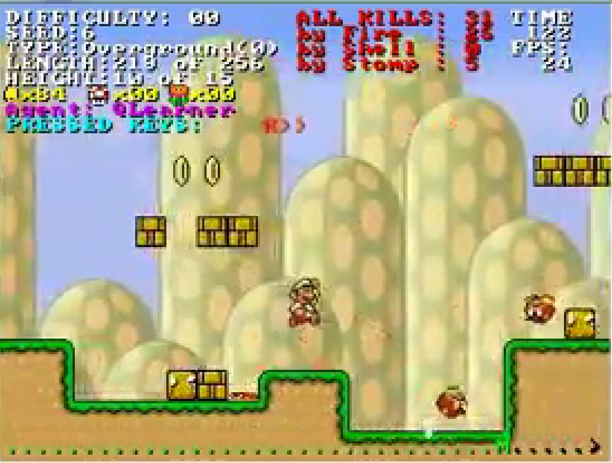
Reinforcement Learning
https://www.youtube.com/watch?v=4cgWya-wjgY

Slide 33

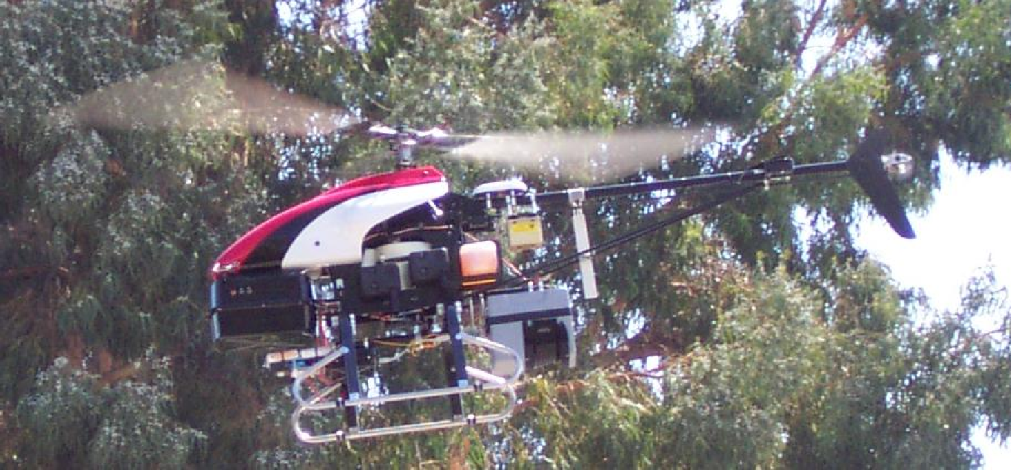
Inverse Reinforcement Learning
Learn policy from user demonstrations
Stanford Autonomous Helicopter http://heli.stanford.edu/ https://www.youtube.com/watch?v=VCdxqn0fcnE

Slide 34
Framing a Learning Problem

Slide 35






Designing a Learning System
Choose the training experience
Choose exactly what is to be learned
– i.e. the target function
Choose how to represent the target function
Choose a learning algorithm to infer the target function from the experience
Training data
Learner
Environment/ Experience
Knowledge
Testing data
Performance Element
41
Based on slide by Ray Mooney

Slide 36
ML in a Nutshell
Tens of thousands of machine learning algorithms
Hundreds new every year
Every ML algorithm has three components:
Representation
Optimization
Evaluation
43
Slide credit: Pedro Domingos

Slide 37
Various Function Representations
Numerical functions
Linear regression
Neural networks
Support vector machines
Symbolic functions
Decision trees
Rules in propositional logic
Rules in first-order predicate logic
Instance-based functions
Nearest-neighbor
Case-based
Probabilistic Graphical Models
Naïve Bayes
Bayesian networks
Hidden-Markov Models (HMMs)
Probabilistic Context Free Grammars (PCFGs)
Markov networks
Slide credit: Ray Mooney

Slide 38
Various Search/Optimization Algorithms
Gradient descent
Perceptron
Backpropagation
Dynamic Programming
HMM Learning
PCFG Learning
Divide and Conquer
Decision tree induction
Rule learning
Evolutionary Computation
Genetic Algorithms (GAs)
Genetic Programming (GP)
Neuro-evolution
Slide credit: Ray Mooney

Slide 39
Evaluation
Accuracy
Precision and recall
Squared error
Likelihood
Posterior probability
Cost / Utility
Margin
Entropy
K-L divergence
etc.
47
Slide credit: Pedro Domingos

Slide 40


ML in Practice
Understand domain, prior knowledge, and goals
Data integration, selection, cleaning, pre-processing, etc.
Learn models
Interpret results
Consolidate and deploy discovered knowledge
Loop
48
Based on a slide by Pedro Domingos

Slide 41
Lessons Learned about Learning
Learning can be viewed as using direct or indirect experience to approximate a chosen target function.
Function approximation can be viewed as a search through a space of hypotheses (representations of functions) for one that best fits a set of training data.
Different learning methods assume different hypothesis spaces (representation languages) and/or employ different search techniques.
49
Slide credit: Ray Mooney

Slide 42
Various Kinds
Supervised learning
Decision tree induction
Linear regression
Logistic regression
Support vector machines & kernel methods
Model ensembles
Bayesian learning
Neural networks & deep learning
Learning theory
Unsupervised learning
Clustering
Dimensionality reduction
Reinforcement learning
Temporal difference learning
Q learning
Evaluation
Applications
54

Slide 43
To apply Machine learning for CV tasks

Slide 44
What is machine Learning

Slide 45
What matters in recognition?
Machine learning methods (e.g., linear classification, deep learning)
Representation (e.g., SIFT, HoG, deep learned features)
Data (e.g., PASCAL, ImageNet, COCO)

Slide 46
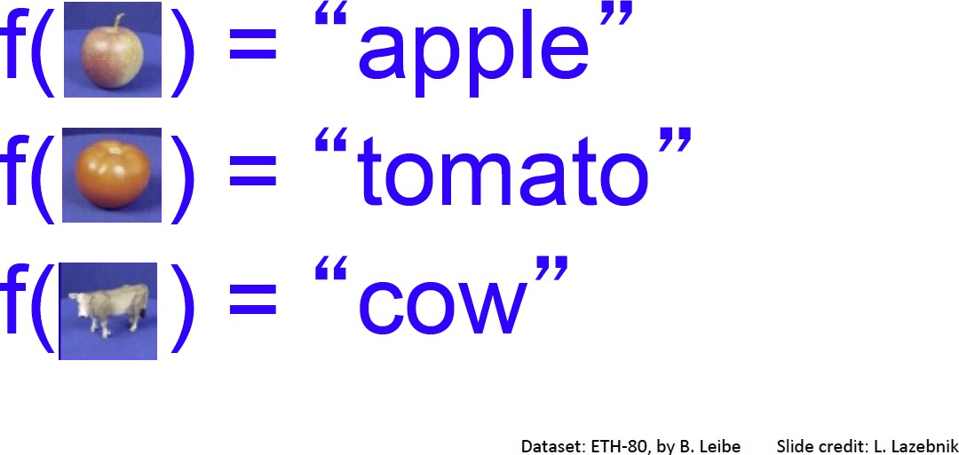
Image Classification:
A core task in Computer Vision
Assume given set of discrete labels, e.g.
{cat, dog, cow, apple, tomato, truck, … }

Slide 47
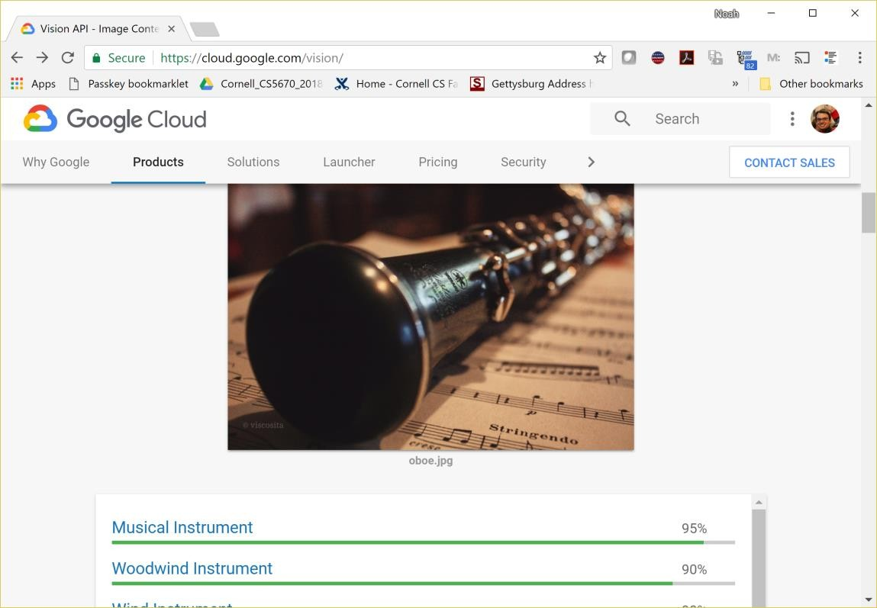
Image classification demo
https://cloud.google.com/vision/
See also: https://aws.amazon.com/rekognition/ https://www.clarifai.com/
https://azure.microsoft.com/en-us/services/cognitive-services/computer-vision/
…

Slide 48
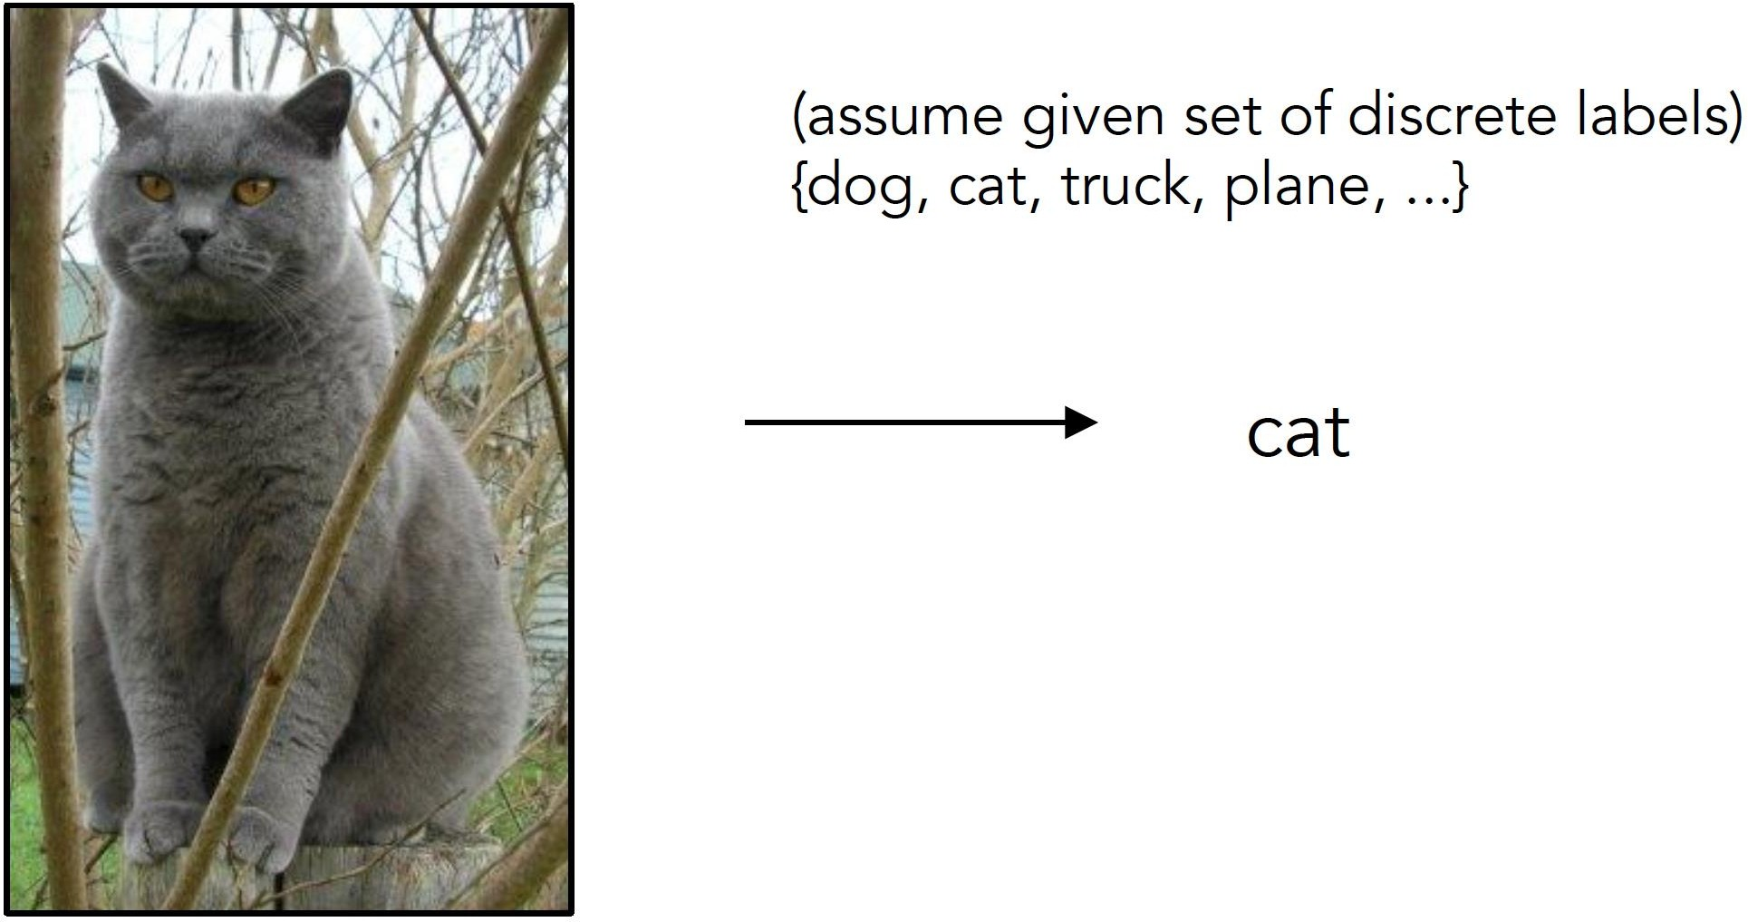
Image Classification
Slides from Andrej Karpathy and Fei-Fei Li
http://vision.stanford.edu/teaching/cs231n/

Slide 49
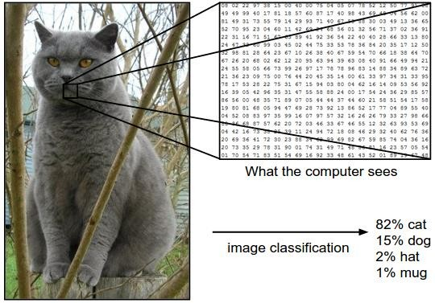
Image Classification: Problem

Slide 50
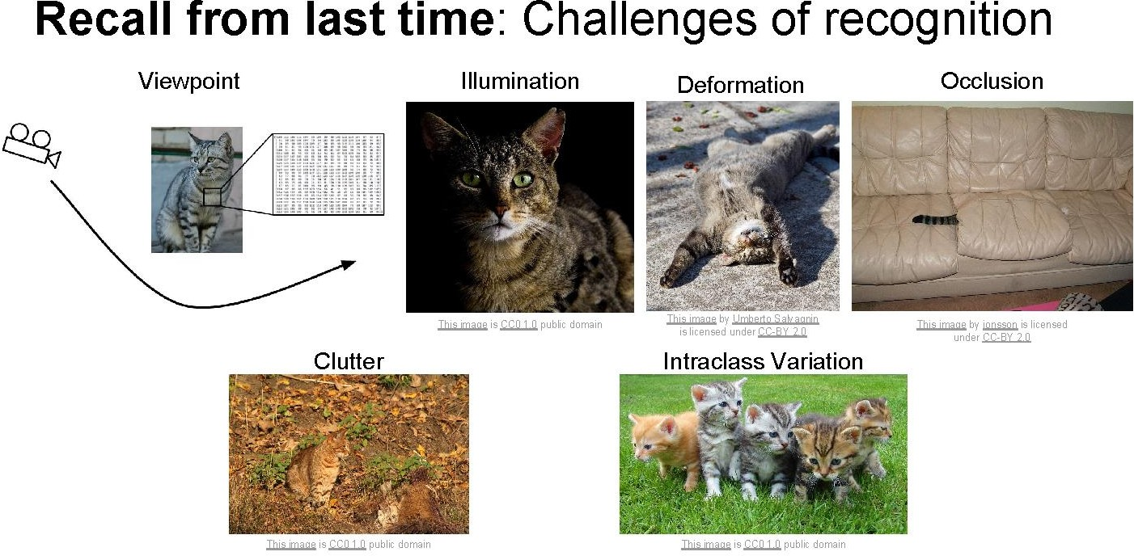

Slide 51
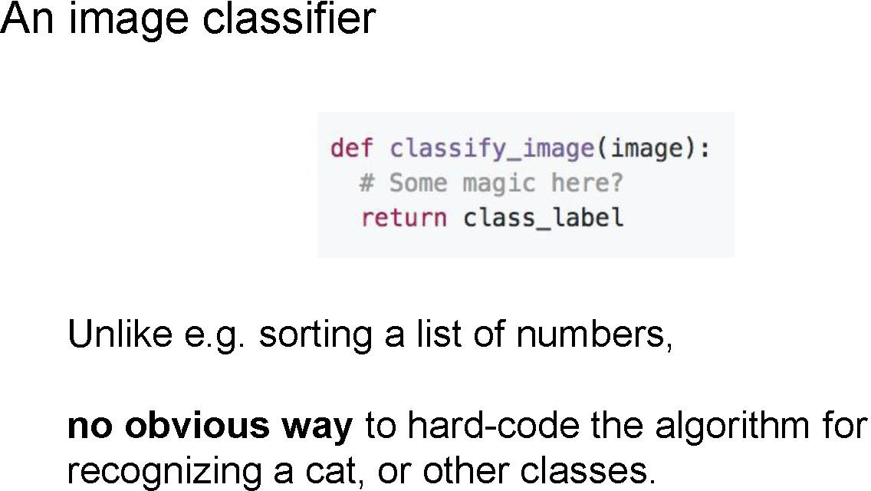
Slide credit: Fei-Fei Li & Justin Johnson & Serena Yeung

Slide 52
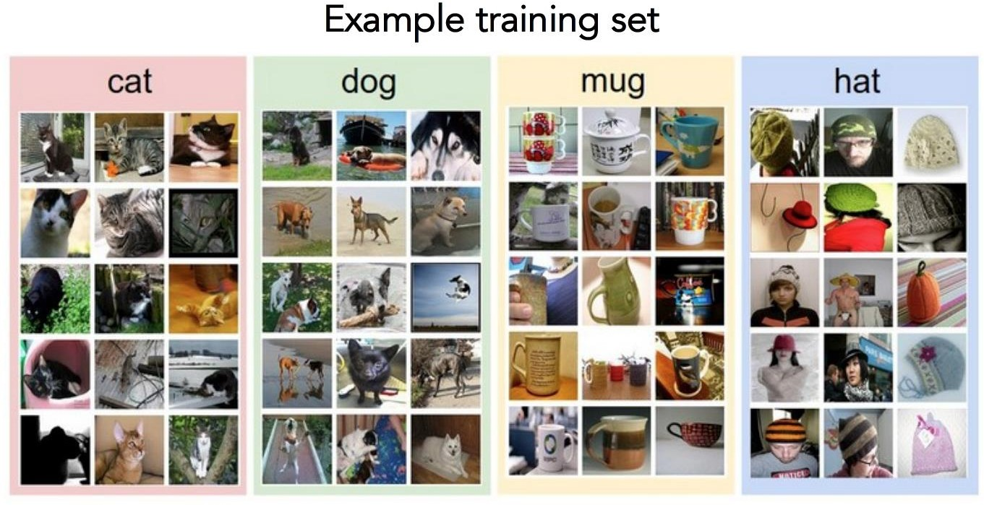
Data-driven approach
Collect a database of images with labels
Use ML to train an image classifier
Evaluate the classifier on test images
Slides from Andrej Karpathy and Fei-Fei Li
http://vision.stanford.edu/teaching/cs231n/

Slide 53
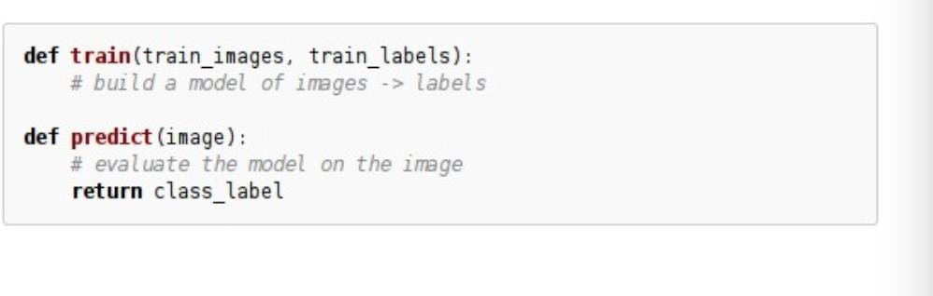
Data-driven approach
Collect a database of images with labels
Use ML to train an image classifier
Evaluate the classifier on test images
Slides from Andrej Karpathy and Fei-Fei Li
http://vision.stanford.edu/teaching/cs231n/

Slide 54
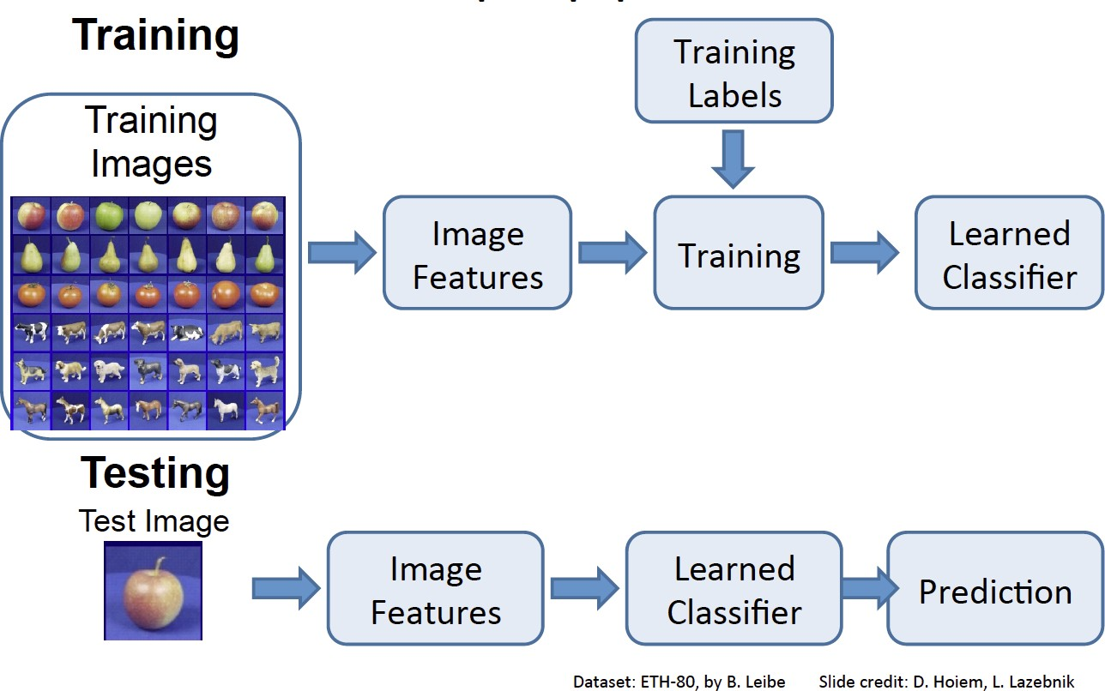

Slide 56
Hyperparameters
What is the best distance to use?
What is the best value of k to use?
These are hyperparameters: choices about the algorithm that we set rather than learn
How do we set them?
– One option: try them all and see what works best

Slide 57
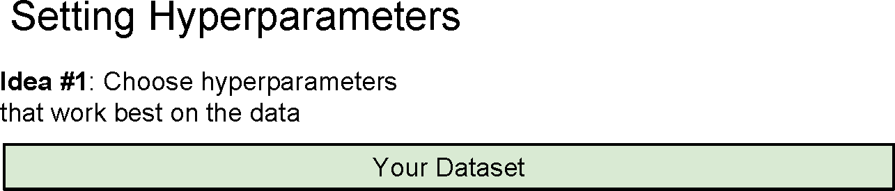

Slide 58
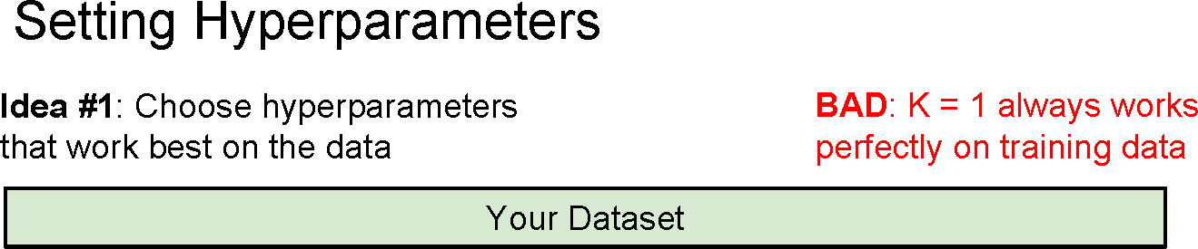

Slide 59
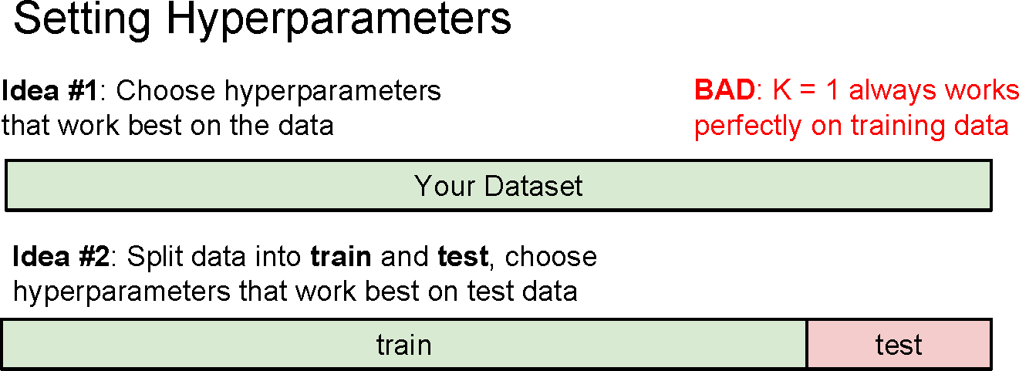

Slide 60
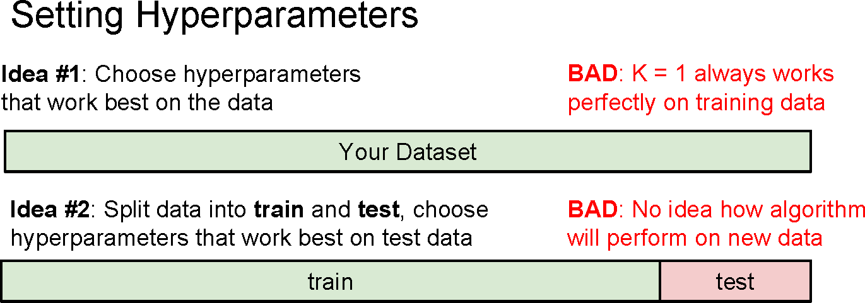

Slide 61
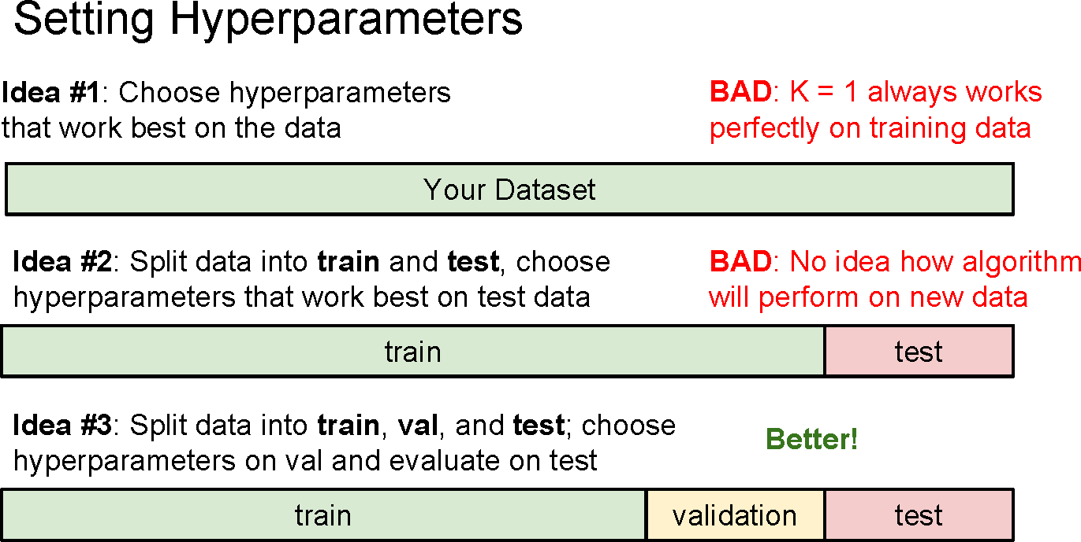

Slide 62
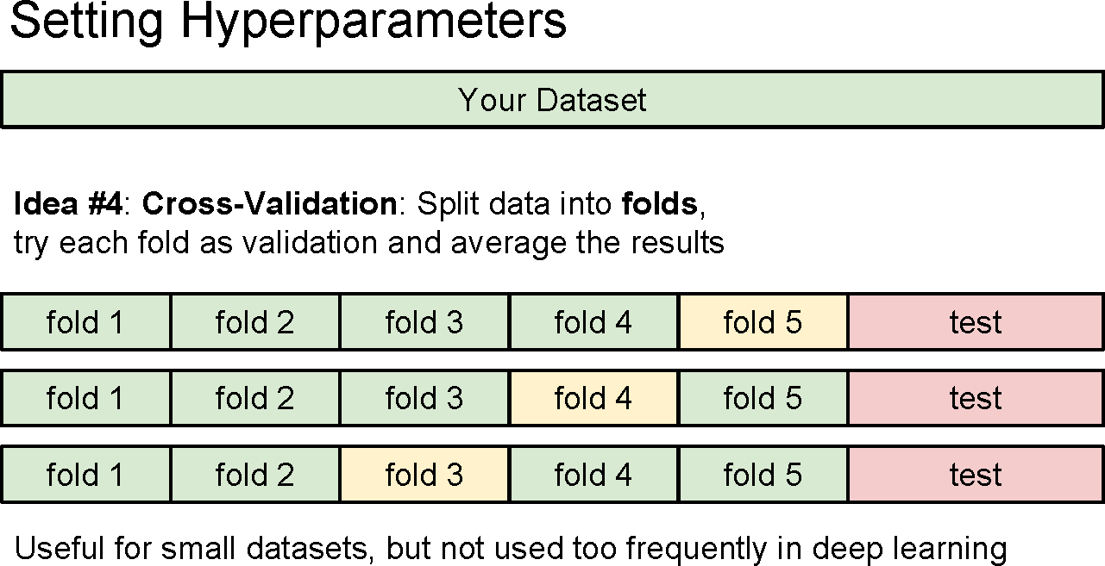

Slide 63
Recap: How to pick hyperparameters?
Methodology
Train and test
Train, validate, test
Train for original model
Validate to find hyperparameters
Test to understand generalizability

Slide 64
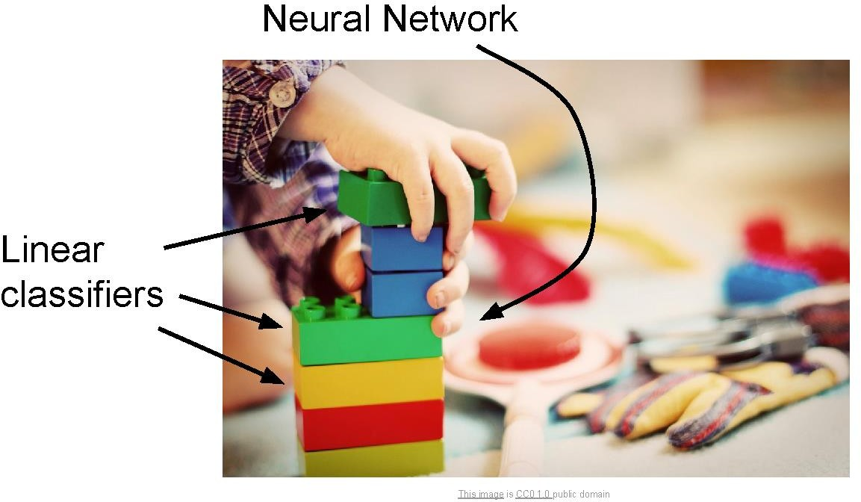
Linear classifiers

Slide 65
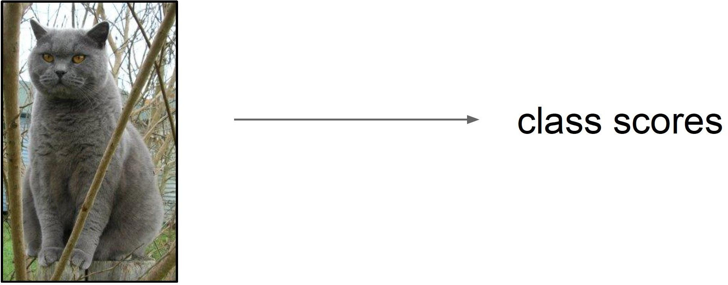
Score function
Slides from Andrej Karpathy and Fei-Fei Li
http://vision.stanford.edu/teaching/cs231n/

Slide 66
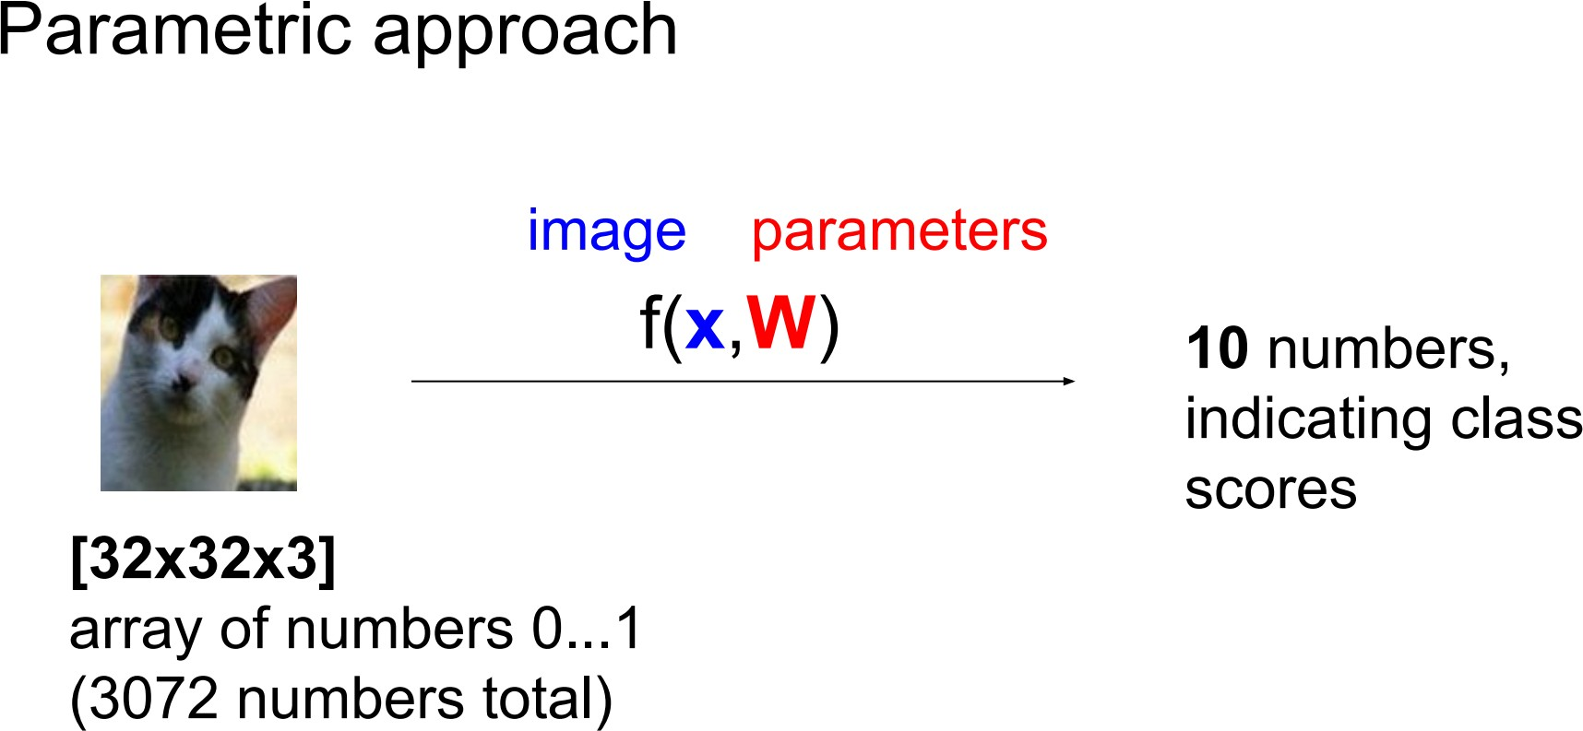
Score function: f

Slide 67
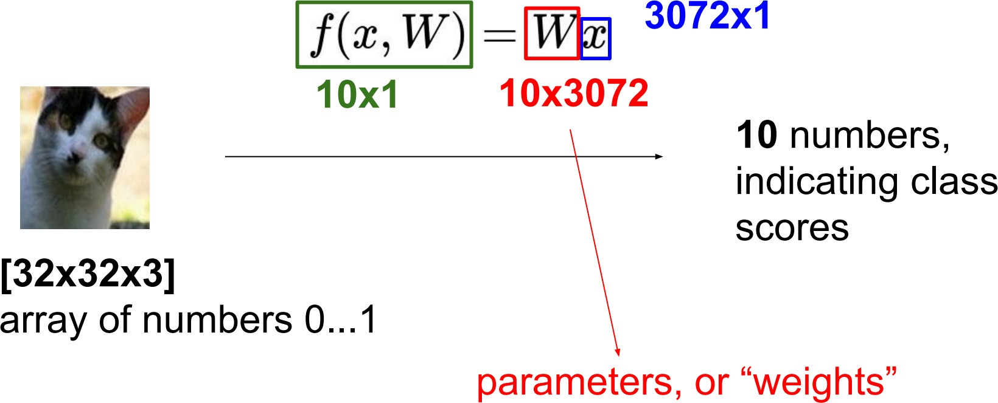
Parametric approach: Linear classifier

Slide 68
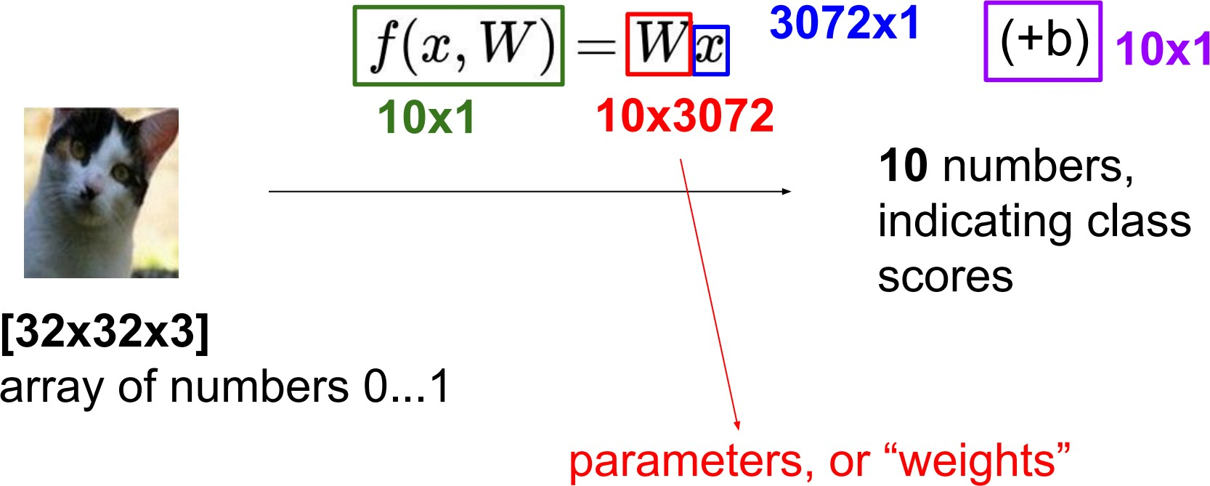
Parametric approach: Linear classifier

Slide 69
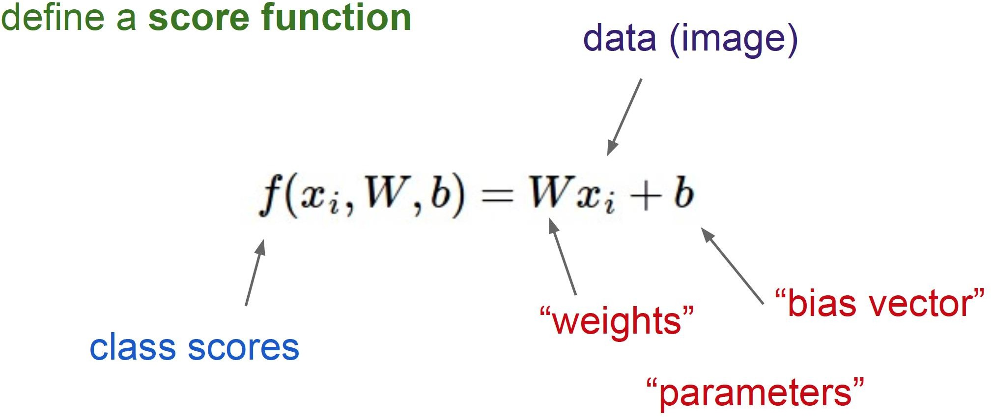
Linear Classifier

Slide 70
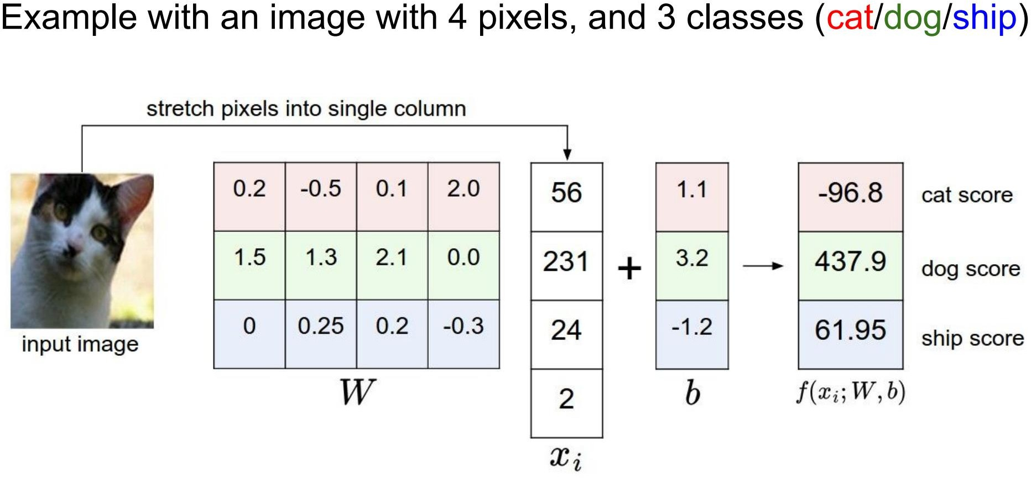

Slide 71
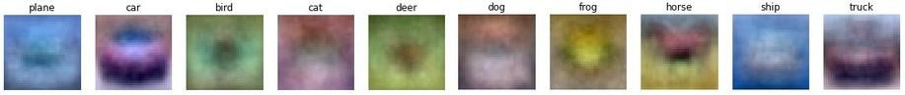
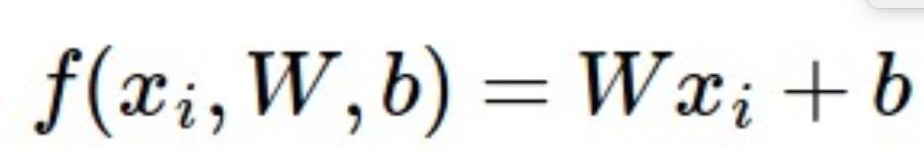
Interpretation: Template matching

Slide 72
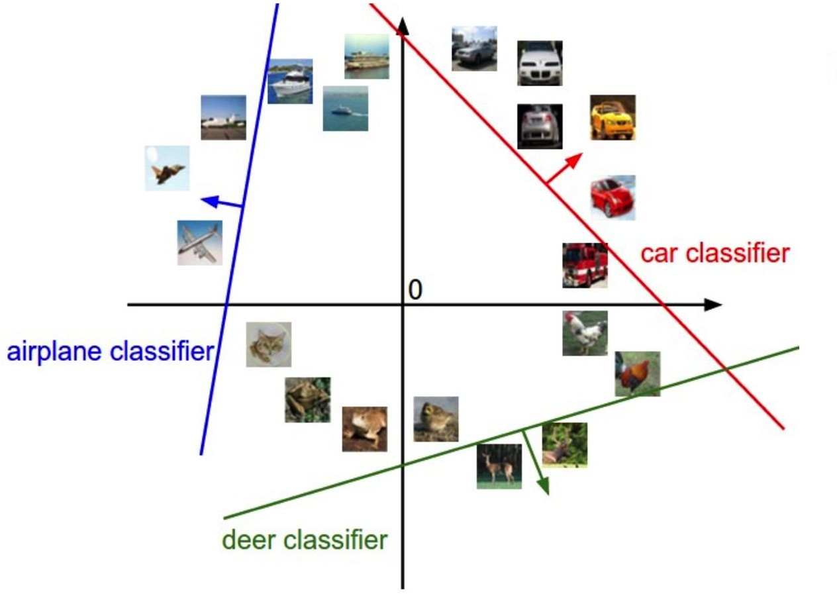
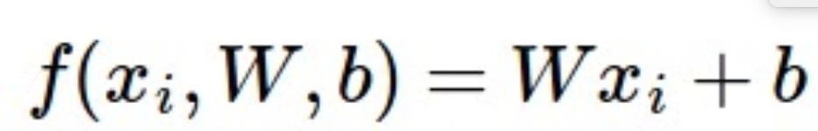
Geometric Interpretation

Slide 73




Linear classifiers
Find linear function (hyperplane) to separate positive and negative examples
x_{i} positive :
x_{i} negative :
x_{i} ⋅ w + b ≥ 0
x_{i} ⋅ w + b < 0
Which hyperplane is best? We will come back to this later

Slide 74
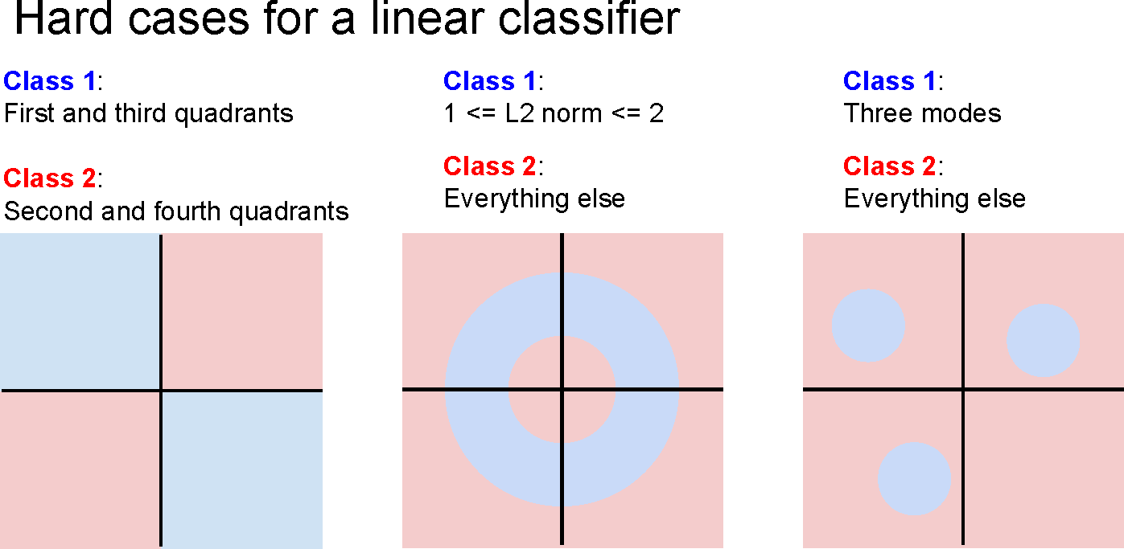

Slide 75
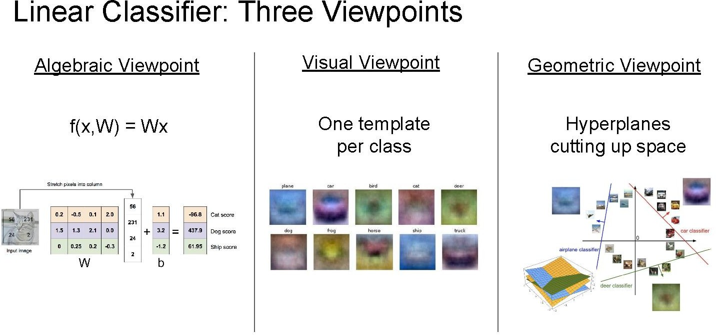

Slide 76
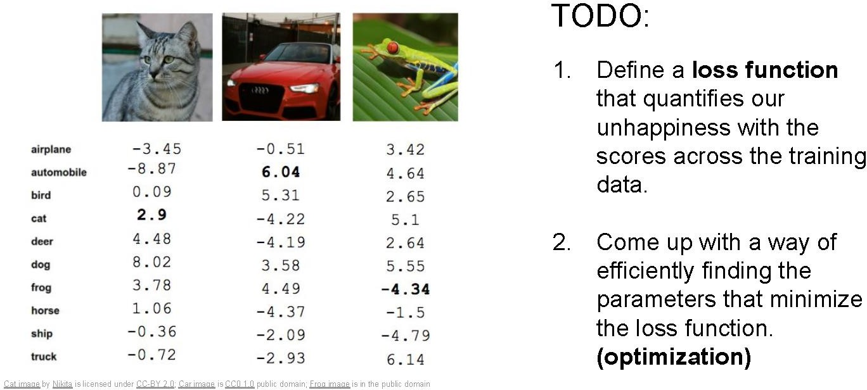
Linear classification
Output scores

Slide 77
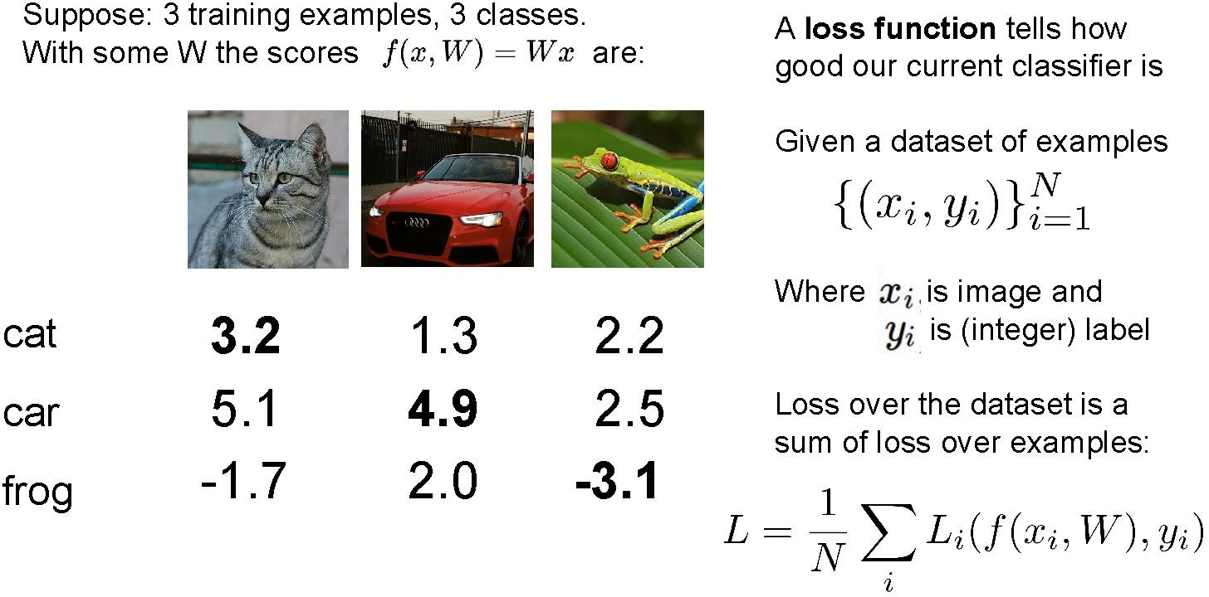

Slide 78
Loss function, cost/objective function
Given ground truth labels (y_{i}), scores f(x_{i}, W)
– how unhappy are we with the scores?
Loss function or objective/cost function measures unhappiness
During training, want to find the parameters W that minimizes the loss function

Slide 79
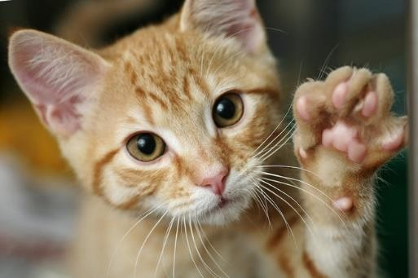
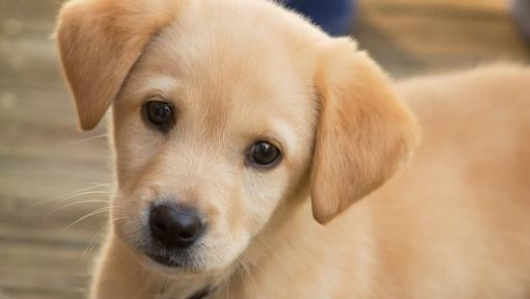

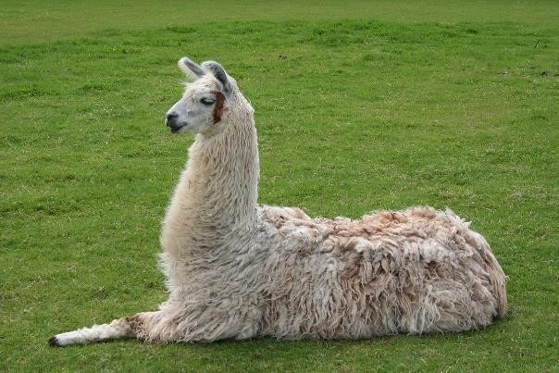
Simpler example: binary classification
Two classes (e.g., “cat” and “not cat”)
– AKA “positive” and “negative” classes
cat
not cat

Slide 80
Linear classifiers
Find linear function (hyperplane) to separate positive and negative examples
x_{i} positive :
x_{i} negative :
x_{i} ⋅ w + b ≥ 0
x_{i} ⋅ w + b < 0
Which hyperplane is best? We need a loss function to decide

Slide 81
What is a good loss function?
One possibility
– Number of misclassified examples
Loss: 2
Loss: 0
Loss: 0
Problems: discrete, can’t break ties
We want the loss to lead to good generalization
We want the loss to work for more than 2 classes

Slide 82
Loss Function Vs Activation Function

Slide 83
Evaluation Metrics
Accuracy
Precision
Recall
F1

